Slide 1
Introduction
How is it done today, and what are the limits of current practice?
Bartenders and Mixologists, very expensive to train and hire.
What's new in your approach and why do you think it will be successful?
Crafts the perfect drink/beverage at the touch of a button, very fast and easy to use (one time investment).
Who cares? If you're successful, what difference will it make?
It can be installed in homes, restaurants and a wide variety of places. It will help bring down the cost of operations.

Slide 2
Introduction
What are the risks and the payoffs?
Risks
Needs to be powered
In commercial applications downtime could result in loss of profits
Could serve a drink which doesn’t match your palette
Payoffs
Much more cost effective
Can work multiple shifts unlike a human
Repeatability and consistency
Suggests new drinks for a new experience
…
How much will it cost? How long will it take?
Around 400-500 $. 6-8 months

Slide 3
Step 1- State the Problem
The project aims to create an efficient solution for blending beverages in the right proportion based on the user's preference and popular recipes. The Mixer Fixer device will have a touch interface that will allow users to select their desired drink, and the device will automatically dispense the precise amount of each component from its multiple canisters. Users can choose from a wide range of classic and unique drink combinations and even try out new and exciting ones suggested by the Mixer Fixer. This device is not only intended for professional bartenders but also for chemists and home enthusiasts, making it a perfect addition to any home.

Slide 4
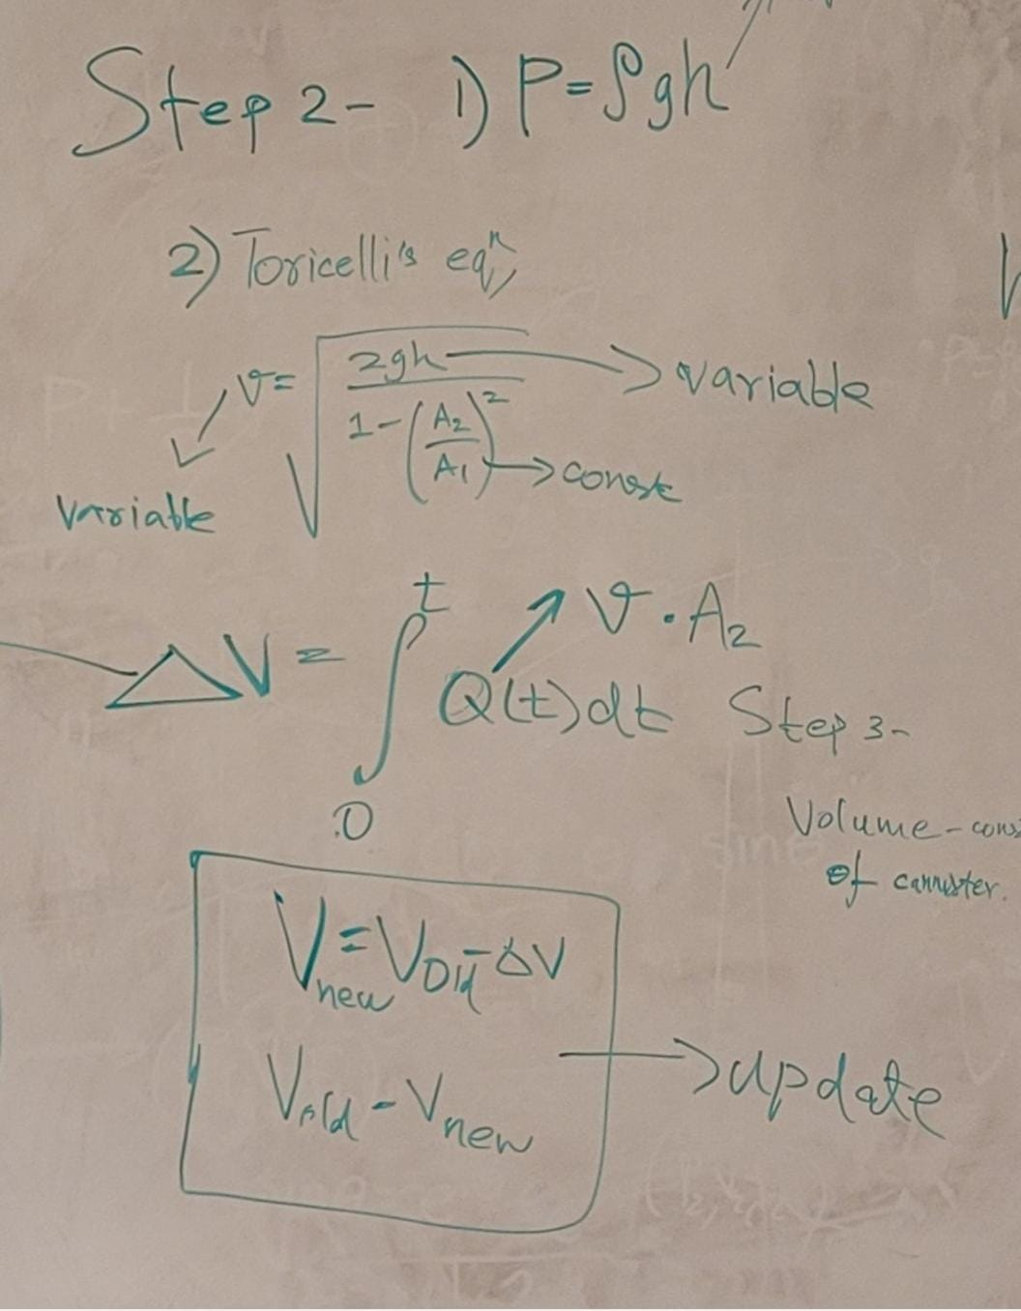

Step 2- Model Physical Processes
The first equation is to keep track of the volume of
the liquid present in the canister.
The second equation gives us the velocity of the
liquid leaving the canister, with the help of which
we calculate the flow rate, which in turn we use to
calculate the time the valve remains open to dispense
the liquid. This equation is often referred to as Torricelli's
equation.
The flow rate is given by velocity times Area.
More on how the time is calculated is explained in Step 4

Slide 5
Step 3- Characterize the Problem
Parameters -
Fixed : Volume of the holding canisters(V), the aperture of the canister and tubing(A1 and A2)
Adjustable: The quantity of the final beverage mixture{0-12oz}
Variables : Mixing ratio(R1), duration for canister valve open(t1, t2)
Thresholds-
Minimum required fluid in canister(Th1 and Th2), Max quantity of output container(Vmax)

Slide 6
Assumptions made -
All liquids have uniform density equivalent to water. (1Kg/m^3)
All calculations in metric units.
Canister (Capacity - 2.6 L) - 15 cm in diameter, 15 cm in height
h1 - 15 cm
Diameter of canister - 15 cm
A1 = 0.07065 m^2
Diameter of pipe - 2 cm
A2 = 0.00031 m^2
k=A2*(((2*g*h)/(1-(A2/A1)^2))^0.5) -> constant in expression from previous slide.
0.00031*(((19.62*h))^0.5)
h1'=(V1-user_volume)/3.14*(7.5*10^-2)^2
h1'=(V1-user_volume)/0.0176625
time=user_volume/0.0013*pow(h1'-h1,0.5)
V1=0.0176625*h1'

Slide 7
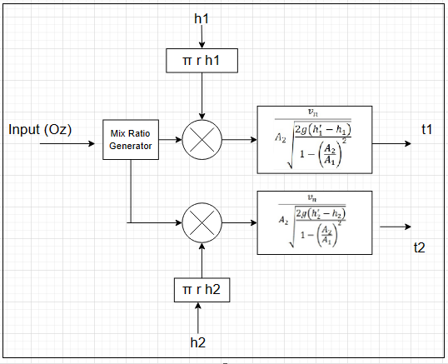
Step 4- Derive the Control Algorithm
Mixer fixer control algorithm

Slide 8
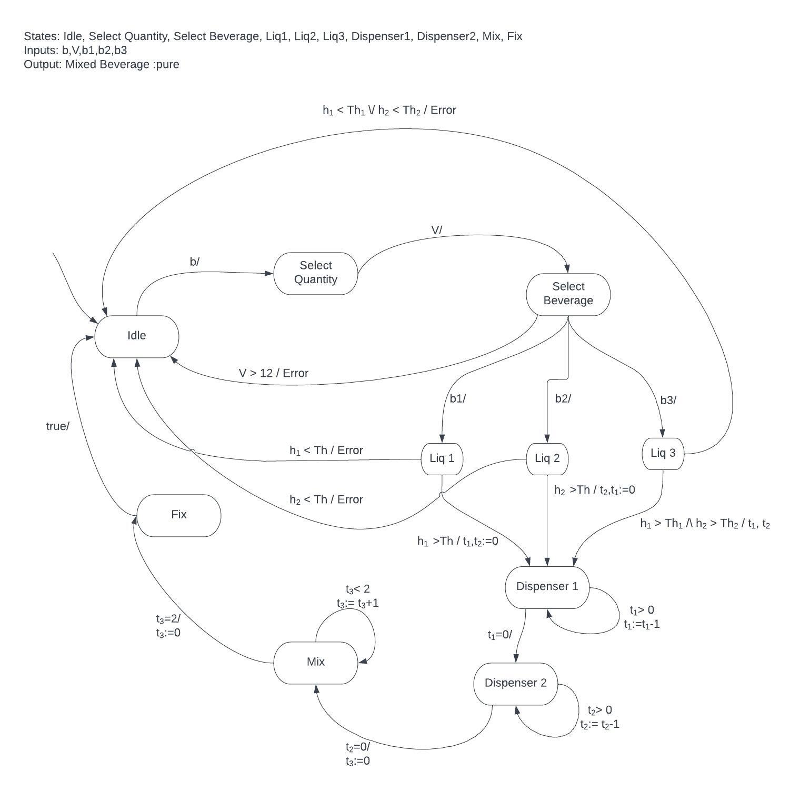
Step 5- Select Models of Computation

Slide 9
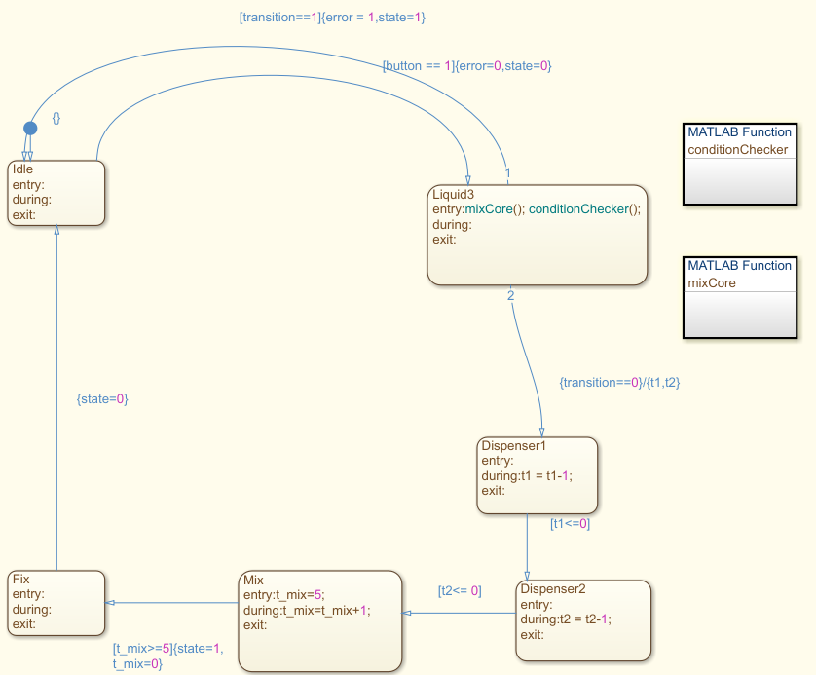
State Machine Refinement
There was scope to further reduce the state transitions.

Slide 10
Step 6 - Specify Hardware
Strain gauge ( HX711 load cell amplifier module) - Product Link
Fan or blades for mixing (12V DC fan)
Boost Converter (to deal with 12V inputs)
Touchscreen ( 7" HDMI capacitive touchscreen display) - Product Link
Custom PCB (Designed using Altium or Circuitmaker) - Based off RPi or 8051 - for current functionality, 8051 will suffice.
Valve for dispensing liquid (12V DC solenoid valve)
Proximity sensor (LJ12A3-4-Z/BX NPN NO 4 mm proximity sensor) - Product Link
Three canisters (One for mixing) and a pipe (made of food-grade plastic or glass)
Valve Actuator (ASCO RedHat II Solenoid Valve) - Product Link
Power Supply (Mean Well LRS-50-5) - Product Link

Slide 11
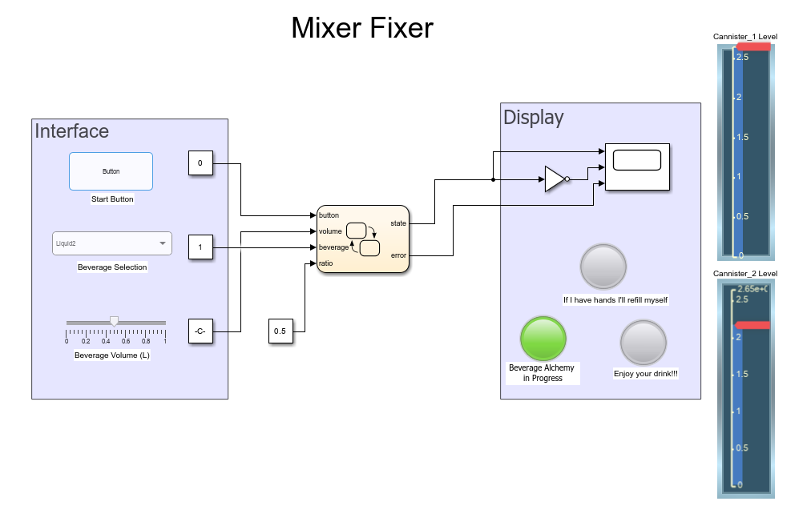
Step 7 - Simulate

Slide 12
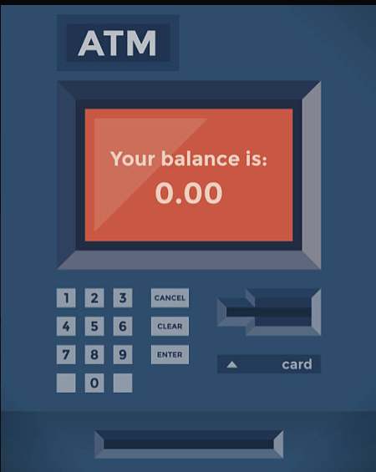
Step 8- Construct

Slide 13
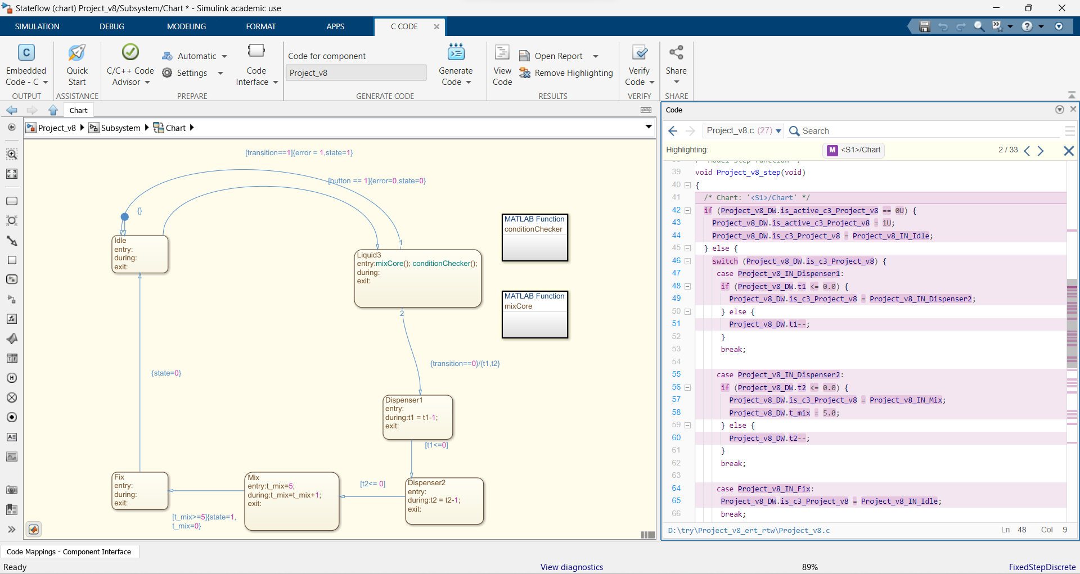
Step 9- Code Synthesize

